Slide 1
Graphs
Representation of Graphs, Depth First Search and Breadth First Search on Graphs, Application of Graphs

Slide 2
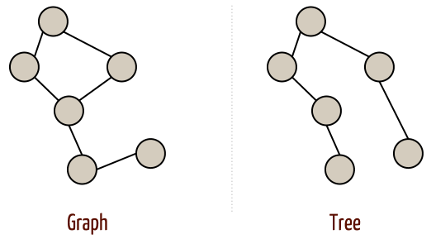
Graph is a non linear data structure.
In tree , hierarchical relationship exist among parent and children(one parent and many children)
In graph, there is no such hierarchical relationships.
Tree is a special case of graph.
The size of graph is the number of nodes in it.
Empty graph has size 0.

Slide 3
Graph Terminologies
A graph G is a data structure consisting of two sets V and E. i.e. G=(V,E)
V is a finite non-empty set of vertices(or nodes).
E is the set of all edges.
v1
v2
v4
v3
V={v1,v2,v3,v4}
E={(v1,v2),(v1,v3),(v1,v4), (v2,v3),(v3,v4)}

Slide 4
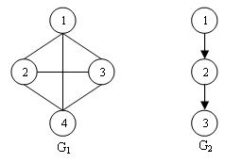
G₁ is an undirected graph and G₂ is a directed graph. V(G₁) = {1,2,3,4} E(G₁) = {(1,2), (1,3), (1,4), (2,3), (2,4), (3,4)} V(G₂) = {1,2,3} E(G₂) = {(1,2), (2,3)}

Slide 5
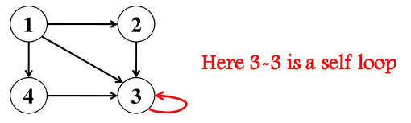
Digraph/Directed Graph: A graph with only directed edges.
V={v1,v2,v3,v4}
E={(v1,v2),(v1,v3),(v2,v3),(v3,v4),(v4,v1)}
Self loop: If there is an edge whose starting and end vertices are same, then it is called self loop
v1
v4
v2
v3

Slide 6
Weighted Graph: A graph in which each edge is given a numerical weight.
Adjacent vertices: A vertex v_{i} is adjacent to another vertex v_{j} if there is an edge from v_{i} to v_{j}
V₄ adjacent to v₁ (or v₄ is the neighbour of v₁ and not v₂).
5
9
8
4
3
v1
v4
v2
v3

Slide 7
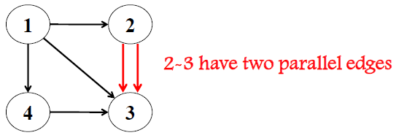
Parallel edges: If there is more than one edge between the same pair of vertices
Multigraph:A graph which has either self loop or parallel edges or both is called a multigraph
Simple Graph: A graph if it does not have any self loop or parallel edges is called a simple graph

Slide 8
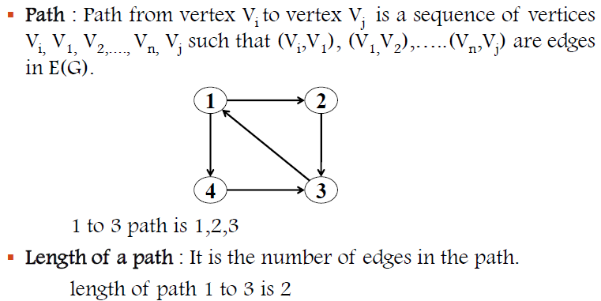
Cyclic Graph:If there is a path containing one or more edges which start from a vertex V_{i} and terminate into the same vertex then the path is cyclic.

Slide 9
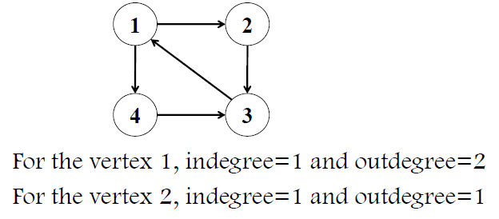
Acyclic Graph: If a graph does not have any cycle then it is called acyclic graph.
Isolated vertex: A vertex is said to be isolated if there is no edge connected from any other vertex to the vertex.
Degree of vertex: The no: of edges connected with vertex v_{i} is called the degree of vertex v_{i}
For diagraph there are 2 degrees indegree and outdegree
Indegree(v_{i}) = no: of edges incident into v_{i}
Outdegree(v_{i}) = No: of edges emerging from v_{i}

Slide 10
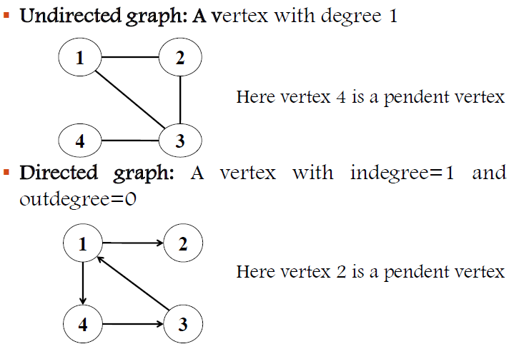
Pendant vertex: A vertex v_{i} is pendant if its indegree=1 and outdegree=0.

Slide 11
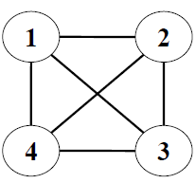
Complete graph: A graph G is said to be complete if each vertex V_{i} is adjacent to every other vertex V_{j} in G.
There are edges from any vertex to all other vertices.
Suppose n is the number of vertices in an undirected completed graph, then total number of edges=n(n-1)/2

Slide 12
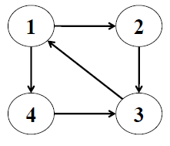
Connected graph: A graph is connected if or every pair of distinct vertices V_{i}, V_{j} in V(G), there is a path from V_{i} to V_{j} in G.
A digraph G is strongly connected if for every pair of vertices v_{i}, v_{j} in G there is a directed path from v_{i} to v_{j} and also from v_{j} to v_{i}.
If digraph G is not strongly connected but the underlying graph (without direction of edges) is connected, then the graph is said to be weakly connected.

Slide 13
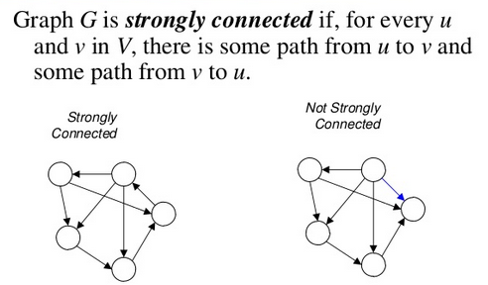
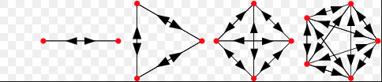
Complete graph

Slide 14
Representation of Graphs
Set Representation
Sequential (matrix) representation or Adjacency Matrix
Linked representation or Adjacency List

Slide 15
Set Representation
Two Sets are maintained.
V, the set of vertices and E, the set of edges which is a subset of V X V.
If the graph is weighted, set E is ordered collection of three tuples, i.e. E=W X V X V, where W is the set of weights.

Slide 16
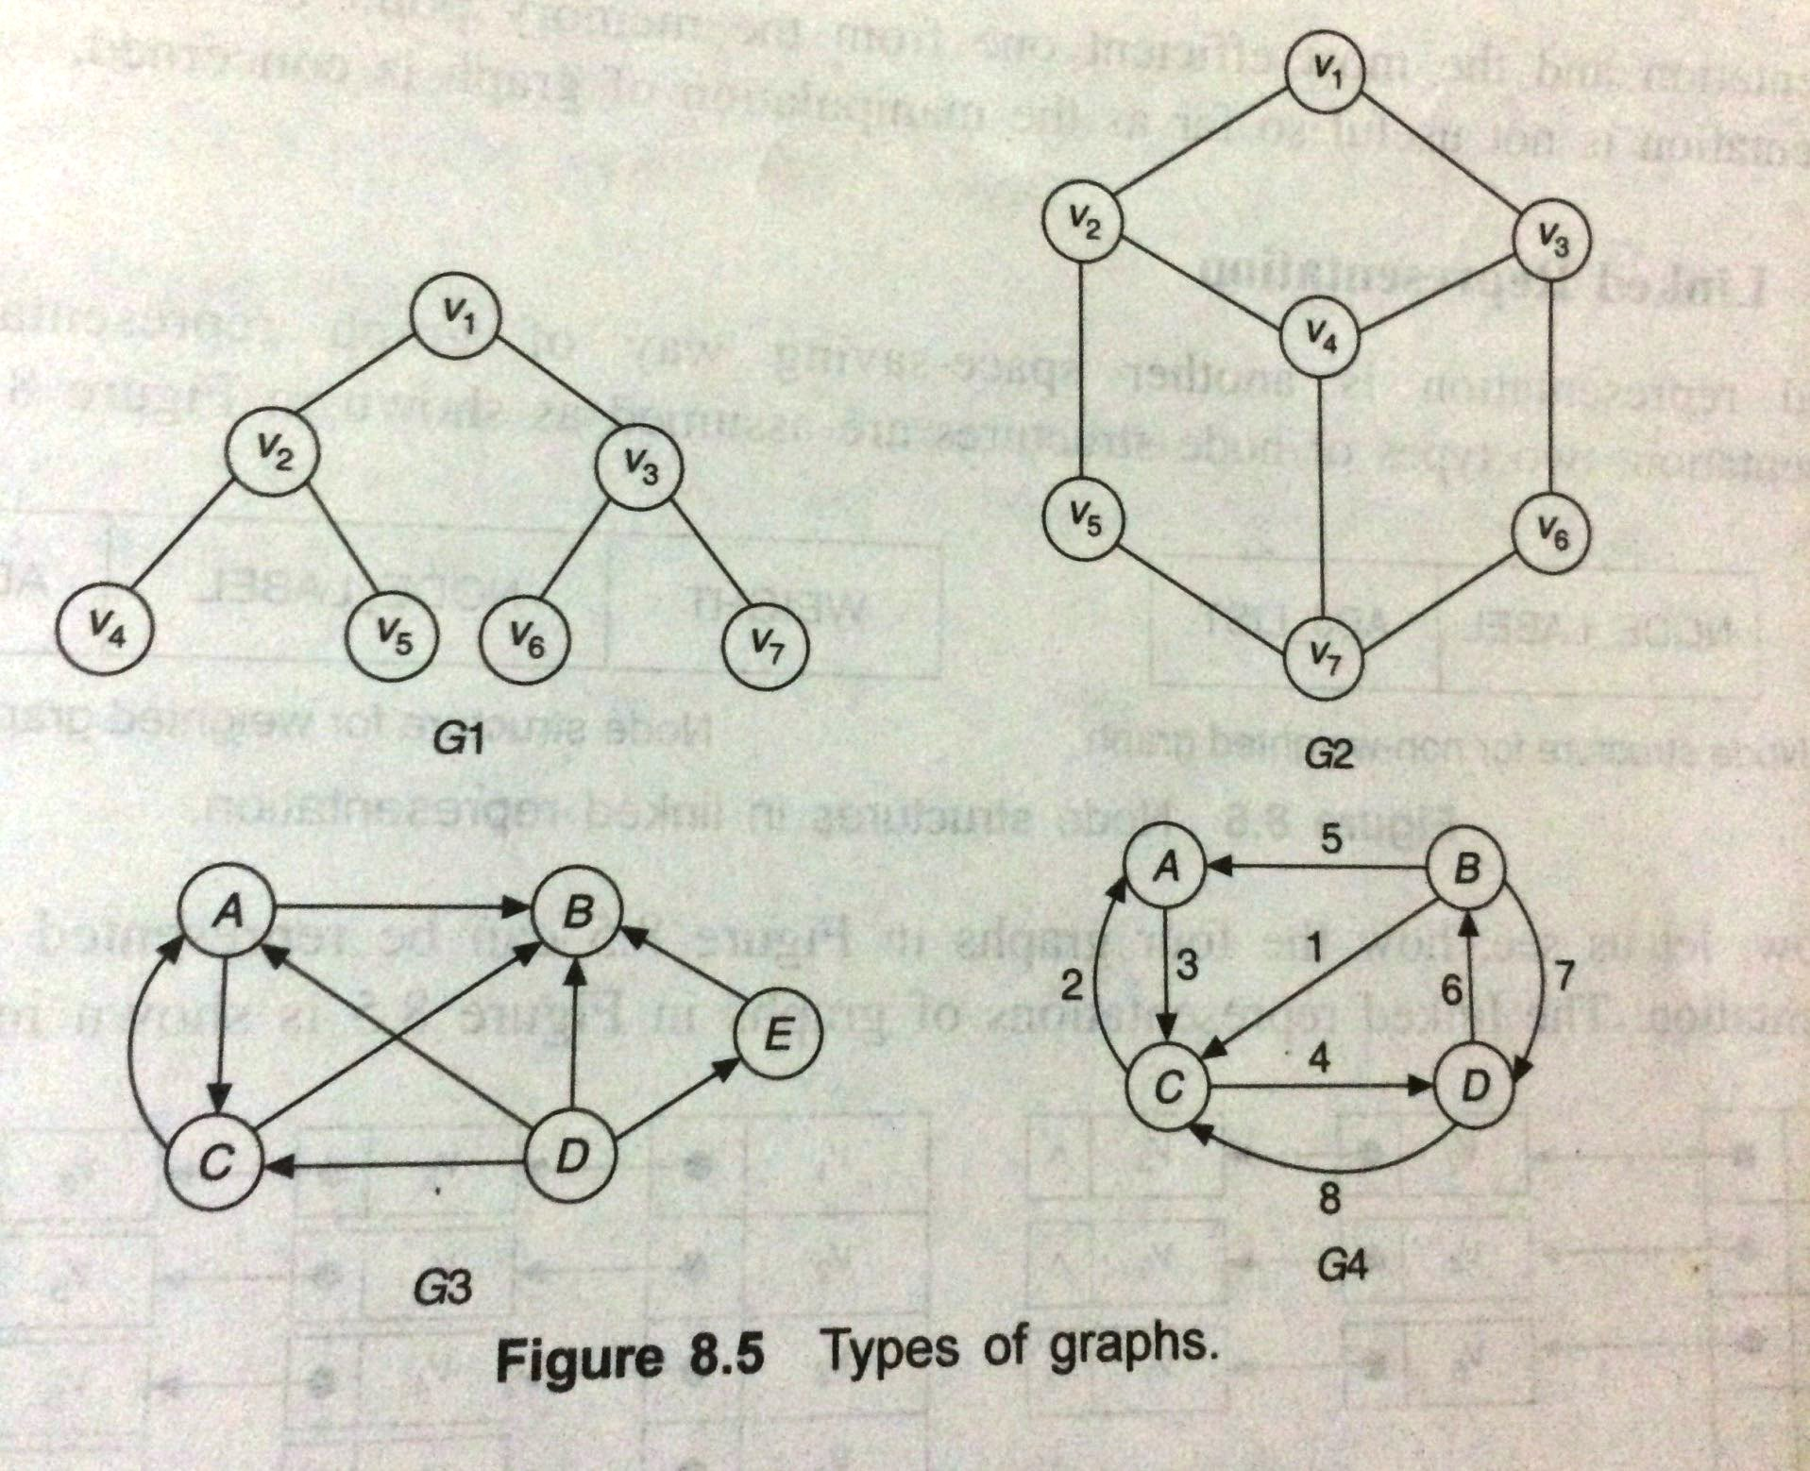

Slide 17
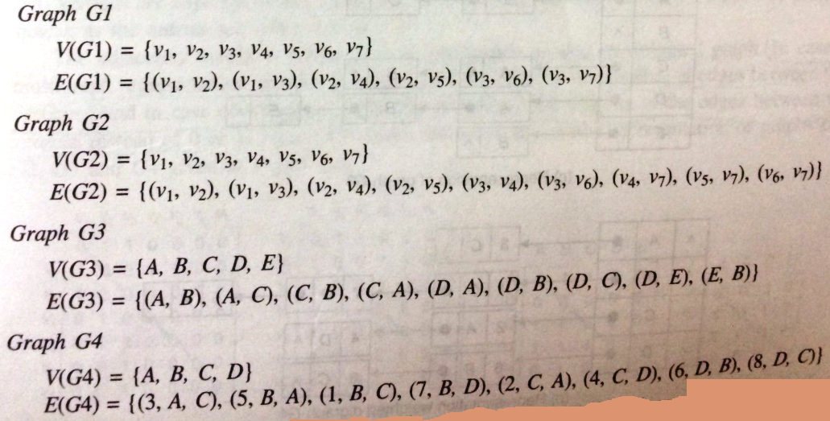

Slide 18
Advantages
Straight forward representation. Hence Easy.
Efficient one in terms of memory.
Drawbacks:
Can not store parallel edges i.e. two identical elements cannot exist.
Difficult to manipulate graph.

Slide 19
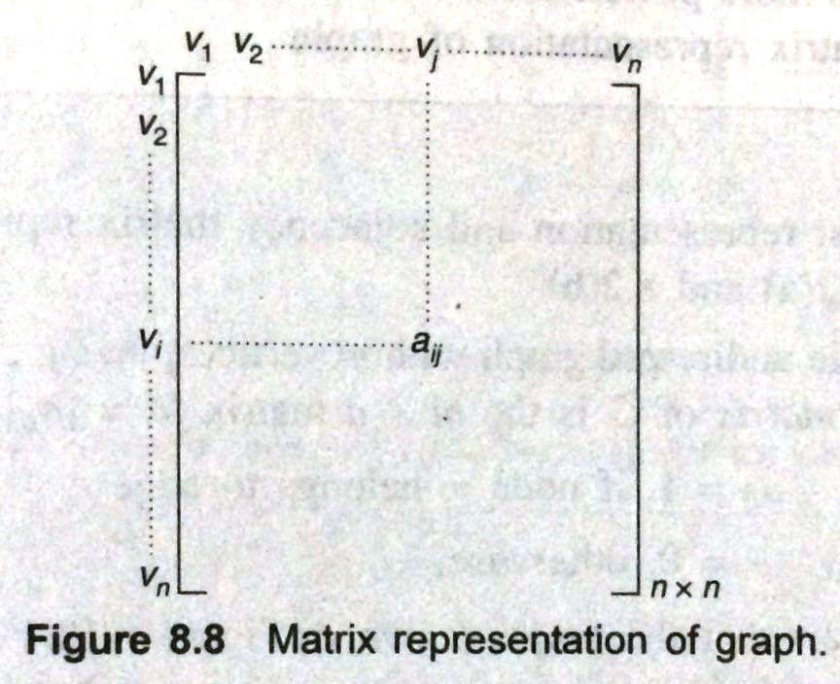
Matrix Representation/ Adjacency Matrix
Most useful way of representing a graph.
Uses a square matrix of order n x n, n being the number of vertices of a graph.
Entries in the matrix based on
a_{ij} =1, if there is an edge from v_{i} to v_{j}
=0, otherwise

Slide 20
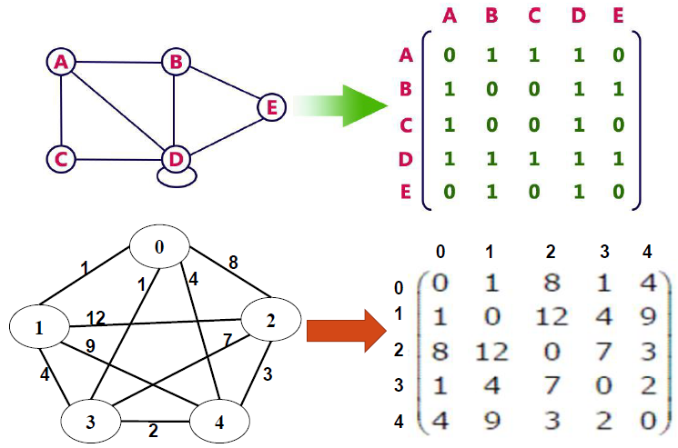
The matrix is known as adjacency matrix because an entry stores the information whether two matrices are adjacent or not.
The matrix is also termed as bit matrix or Boolean matrix as the entries are either a 0 or 1.

Slide 21
Q) Write adjacency matrix representation of the foll graph structures

Slide 22
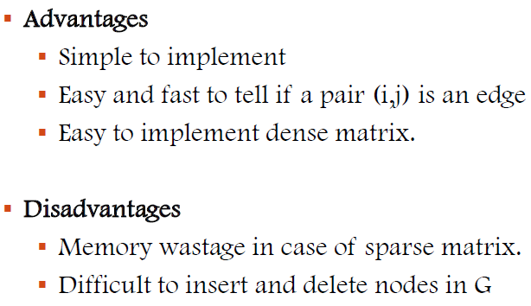

Slide 23


Linked Representation/ Adjacency List
There are two types of node structures;

Slide 24
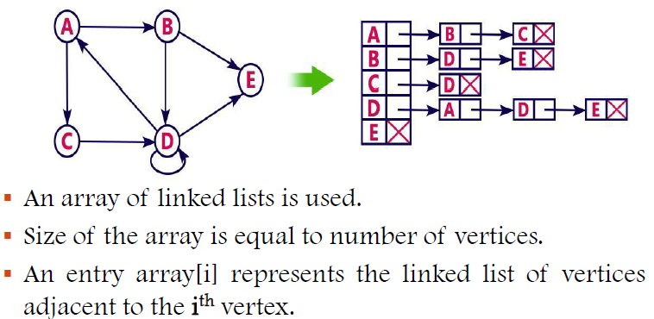

Slide 25
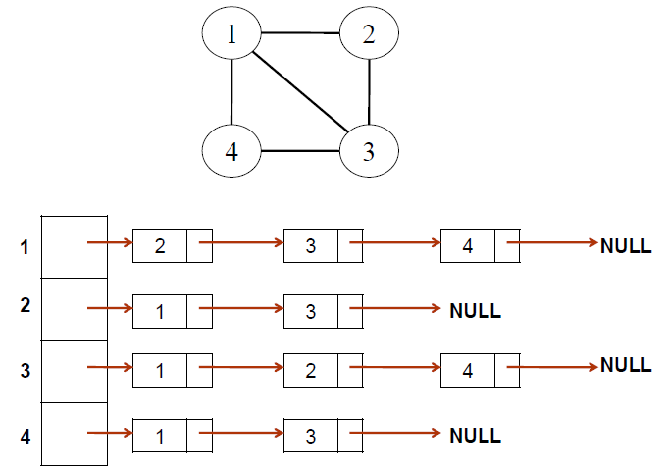

Slide 26
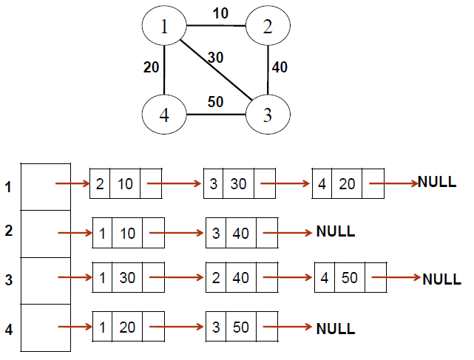

Slide 27
Q) Write adjacency list representation for the following graphs

Slide 28
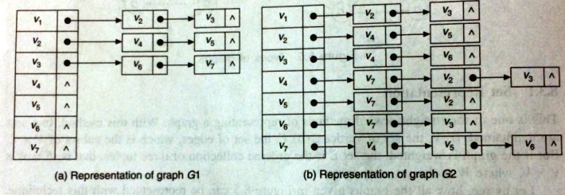

Slide 29
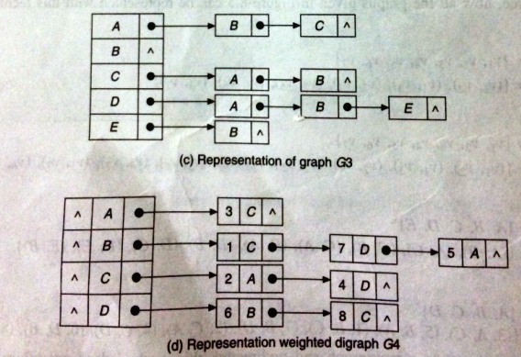

Slide 30
Comparison among various representations
Adjacency matrix representation
Manipulation of data is easy.
Easy to search for an edge in graph.
Allows storing of parallel edges.
has the disadvantage that it always requires an nxn matrix with n vertices, regardless of number of edges.
If the graph is sparse majority of elements are null.
Set Representation
Straight forward representation. Hence Easy.
Efficient one in terms of memory.
Manipulation of data is very difficult.
Difficult to search for an edge in graph.
Linked List representation
Space saving method since dynamic in nature.
Insertion, Deletion, Merging easier
Searching for an edge takes more time compared to adjacency matrix.
Pointer fields are used as extra fields in addition to data fields.
Considering overall performance, Matrix representation is more powerful than all.

Slide 31
Graph Traversals
Traversal of a graph means visiting all vertices of the graph exactly once.
There are two graph traversal methods:
Depth First Search(DFS)
Breadth First Search(BFS)
Difference between tree and graph traversals:
There is no first node or root node in a graph, hence traversal can start from any node.
All nodes are traversed from first node of a tree, but in a graph only nodes reachable from starting node is traversed. So to traverse remaining nodes another starting node has to be selected.
Tree Traversal will visit a node exactly once while in a graph same node can be visited more than once. So status of each node has to be maintained in graph so that it is visited only once.
Tree has unique traversal eg: inorder traversal on tree will always give same sequence. This is not the case for a graph.

Slide 32
Depth First Search
Depth First Search algorithm(DFS) traverses a graph in a depthward motion.
It uses stack implementation.
Algorithm DFS
Input: v is the starting vertex
Output: An array visit giving the order of visit
DS: stack, matrix representation of graph, and array visit
Push starting vertex, v into stack.
While stack not empty do
1. Pop a vertex v
2. If v is not in visit then
2.1. visit the vertex v
2.2. store v in visit
2.3. push all adjacent vertices of v in stack.
3. EndIf
End while

Slide 33
DFS Example 1
After DFS Traversal : 1 2 3 4 (here 1 is taken as the starting vertex)

Slide 34
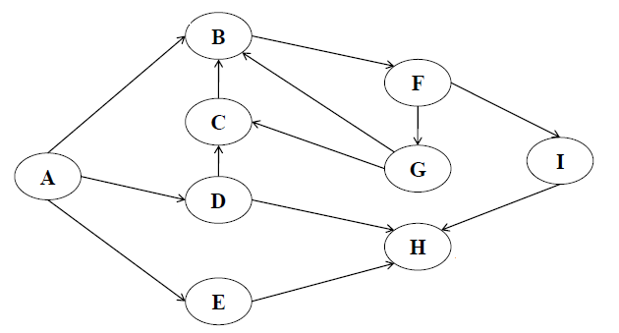
DFS Example 2
After DFS Traversal : A B F G C I H D E (here A is taken as the starting vertex)

Slide 35
Breadth First Search
Breadth First Search algorithm(BFS) traverses a graph in a level wise order.
Level by level traversal.
First visit all vertices in a level and move on to next level.
It uses queue implementation.
Algorithm BFS
Input: v is the starting vertex
Output: An array visit giving the order of visit
DS: queue, matrix representation of graph and array visit.
Insert starting vertex, v into queue.
While queue not empty do
1. Remove a vertex v located at front of queue.
2. If v is not in visit then
2.1 visit the vertex v
2.2 store v in visit
2.3. Insert all adjacent vertices of v in Queue.
3. EndIf
End while

Slide 36
BFS Example 1
After BFS Traversal : 1 2 4 3 (here 1 is taken as the starting vertex)

Slide 37
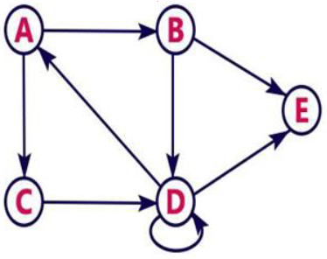
BFS Example 2
After BFS Traversal : A B C D E (here A is taken as the starting vertex)

Slide 38
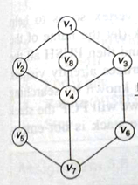
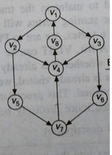
Do DFS and BFS Traversals on the following Graphs:

Slide 39
Note:
DFS and BFS traversals result in acyclic graph.
DFS and BFS will not give same order of vertices for a graph.
DFS and BFS can be employed to decide whether there is a path from a given vertex v_{i} to another vertex v_{j} and if it exists then trace the path from v_{i} to v_{j}.
DFS and BFS cannot visit a vertex say v_{i} if there is no path from the starting vertex to v_{i}.

Slide 40
Application of Graph structures
1. Transportation problem(or Shortest path problems)
i
j
a
d
l
A
b
k
c
g
e
B
f

Slide 41
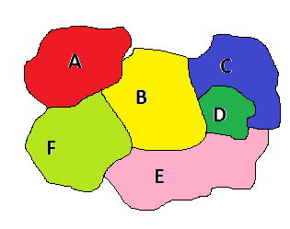
2. Map Colouring
No two adjacent regions of the graph will have same color.
C
D
A
B
F
E

Slide 42
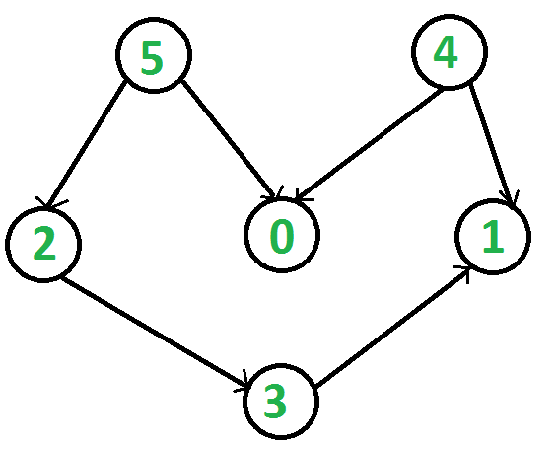
3. Topological Sort
A topological sort or topological ordering of a directed graph is a linear ordering of its vertices such that for every directed edge uv from vertex u to vertex v, u comes before v in the ordering.

Slide 43
Application contd.
4. Flowchart of a program.
5. Graphs are nothing but connected nodes(vertex). So any network related, routing, finding relation, path etc related real life applications use graphs(.i.e. Source-Destination Networks)
Connecting with friends on social media, where each user is a vertex, and when users connect they create an edge.
Using GPS/Google Maps/Yahoo Maps, to find a route based on shortest route.
On eCommerce websites relationship graphs are used to show recommendations.

Slide 44
(DS LAB) Creation of Adjacency Matrix
void insert()
{
int i,j,item;
int cho;
printf("Enter the no of vertices\n");
scanf("%d",&n);
printf("Enter the vertices\n");
for(i=0;i<n;i++)
scanf("%d",&a[i]);
for(i=0;i<n;i++)
{
for(j=0;j<=n;j++)
m[i][j]=0;
}

Slide 45
for(i=0;i<n;i++)
{
printf("\ndo u want adjacent node for %d (1/0) : ",a[i]);
scanf("%d",&cho);
while(cho==1)
{
printf("\nEnter the adjacent node:");
scanf("%d",&item);
for(j=0;j<n;j++)
{
if(a[j]==item)
break;
}
m[i][j]=1;
printf("\nDo u want more nodes for %d (1/0) : ",a[i]);
scanf("%d",&cho);
}
}

Slide 46
DFS CODE
void D_first()
{
int visit[67],loc,i,j,k,tmp;
for(i=0;i<n;i++)
visit[i]=0;
push(a[0]);
while(top!=-1)
{
tmp=pop();
for(loc=0;loc<n;loc++)
{
if(a[loc]==tmp)
break;
}
if(visit[loc]==0)
printf("%d ",a[loc]);
visit[loc]=1;
for(k=0;k<n;k++)
{
if((m[loc][k]==1)&&visit[k]==0)
{
push(a[k]);
}
}
}
}

Slide 47
BFS Code
void B_first()
{
int visit[67],loc,i,j,k,tmp;
for(i=0;i<n;i++)
{
visit[i]=0;
}
enqueue(a[0]);
while(front!=-1)
{
tmp=dequeue();
for(loc=0;loc<n;loc++)
{
if(a[loc]==tmp)
break;
}
if(visit[loc]==0)
printf("%d ",a[loc]);
visit[loc]=1;
for(k=0;k<n;k++)
{
if(m[loc][k]==1&&visit[k]==0)
{
enqueue(a[k]);
}
}
}
}

Slide 48
Creation of Adjacency List(LL)
int main()
{
int i,j,item;
struct tree *newnode,*ptr;
int cho;
printf("Enter the no of vertices\n");
scanf("%d",&n);
printf("Enter the vertices\n");
for(i=0;i<n;i++)
{
newnode=(struct tree*)malloc(sizeof(struct tree));
scanf("%d",&newnode->data);
newnode->link=NULL;
insert(newnode);
}

Slide 49
for(i=0;i<n;i++)
{
printf("\ndo u want adjacent node for %d (1/0) : ",info[i]->data);
scanf("%d",&cho);
ptr=NULL;
while(cho==1)
{ printf("\nEnter the adjacent node:");
newnode=(struct tree*)malloc(sizeof(struct tree));
scanf("%d",&newnode->data);
newnode->link=NULL;
for(j=0;j<n;j++)
{ if(info[j]->data==newnode->data)
break;
}
if(ptr==NULL)
{
info[i]->link=newnode;
ptr=newnode;
}
else
{
ptr->link=newnode;
ptr=newnode;
}
printf("\nDo u want more nodes for %d (1/0) : ",info[i]->data);
scanf("%d",&cho);
}
}

